Slide 1

https://github.com/ridingintraffic/git-good https://github.com/ridingintraffic/git-good.git
Git good

Slide 2

What is git?
VCS – version control system
Snapshots, not differences, nor deltas
Series of snapshots of a tiny filesystem
Every commit is a new snapshot
no changes no new file stored
Everything is local!
offline!
Every file is checksummed!

Slide 3
why git?
Everything is “code”
Github offers free private repos
File syncing
Version history of text files
Devops ¯\_(ツ)_/¯
Configuration as code
Infrastructure as code

Slide 4

Github Freebies
Markdown is rendered
Markdown just works well in git
Githubpages free static hosting and cms
or old school text files are fine too

Slide 5

how git?
make files
Add
Commit
Push

Slide 6

You will mess up
It’s ok
It’s all just files anyway
Ohshitgit.com
Keep notes of git commands
cd ../
rm –rf my-git-repo
git clone https://github.com/myuser/my-git-repo.git

Slide 7


Git branching
Everyone always uses master
don’t
lazy/bad habit
You aren’t sole contributor

Slide 8

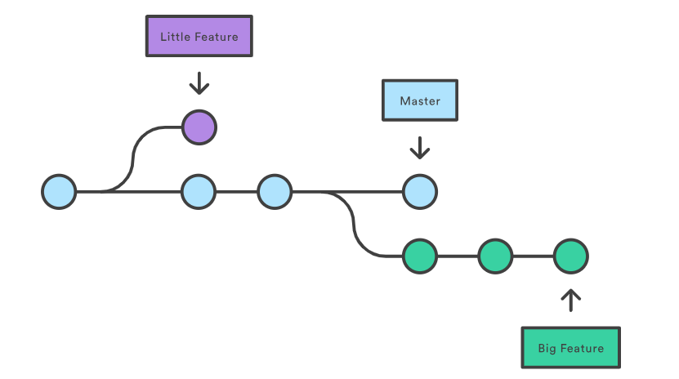
Git branching
Feature branches
Your “changeset” is a branch
Then commit, push/merge, PR
Order in the chaos

Slide 9

Simple workflow
Pull from master
Git branch fettis
Git checkout fettis
<change files>
Git commit –a –m “good commit”
Git push origin fettis; #my branch
<open pull request>

Slide 10

Commit messages…

Slide 11

Commit messages…
“ Re-establishing the context of a piece of <code> is wasteful. We can’t avoid it completely, so our efforts should go to reducing it[as much] as possible. Commit messages can do exactly that and as a result, a commit message shows whether a developer is a good collaborator. ”
A project’s long-term success rests (among other things) on its maintainability, and a maintainer has few tools more powerful than his project’s log.
This goes beyond code.
It changes how you think and write

Slide 12

Commit squashing…
squash before PR
Cleaner
Rewrite bad commit messages

Slide 13

protect yourself
from yourself
restrict master
.gitignore https://github.com/github/gitignore
hooks https://github.com/awslabs/git-secrets
after the fact:
https://rtyley.github.io/bfg-repo-cleaner/

Slide 14

hooks?
things that run during different steps
local and server side
https://git-scm.com/docs/githooks
confusing but useful
simple automation

Slide 15
devops - automation
webhooks: Jenkins ci\cd Docker
attribution : history what changed? who changed?

Slide 16

demo ¯\_(ツ)_/¯

Slide 17
Links
https://ohshitgit.com/
how to branch https://hackernoon.com/understanding-git-branching-2662f5882f9
commit philosophy https://chris.beams.io/posts/git-commit/
squashing https://blog.carbonfive.com/2017/08/28/always-squash-and-rebase-your-git-commits/
https://rtyley.github.io/bfg-repo-cleaner/

Slide 18
Links
https://rtyley.github.io/bfg-repo-cleaner/
https://github.com/awslabs/git-secrets
https://git-scm.com/docs/githooks

Slide 19
asdf

